Slide 1


NLP applications, Challenges and The Future of NLP Session No.: 3 Course Name: Natural Language Processing Course Code: R1UC616C Instructor Name: Mr. Amit Yadav Duration: 50 mins

Slide 2
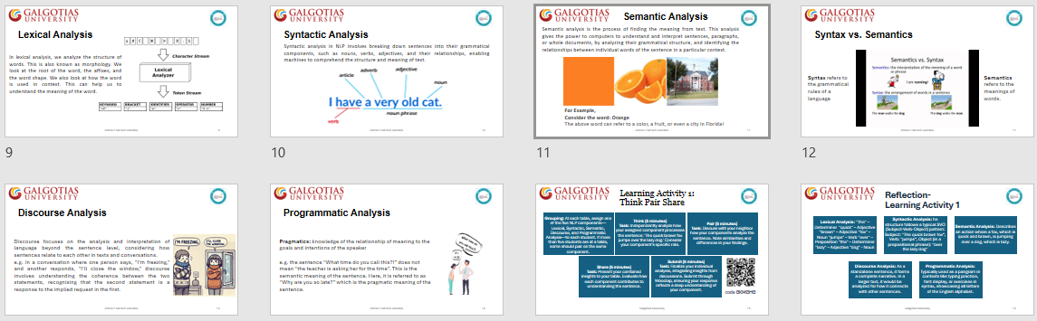
Review of the key concepts of session no. 2

Slide 3
Reflect on the responses of post session activity

Slide 4
At the end of this session students will be able to
LO 1: Practical Application of NLP Technologies: Demonstrate an understanding of how NLP technologies such as real-time translation and sentiment analysis can enhance user experiences, specifically within the context of the "CityScape Tours Mobile App."
LO 2: Comprehensive Analysis of NLP Development: Identify and categorize the benefits, challenges, and future possibilities of NLP, highlighting their influence on the technology's evolution and potential impact.

Slide 5
Session Outline
1. Everyday applications of NLP
2. Learning Activity 1: Problem Based Learning
3. Benefits of NLP
4. Challenges of NLP
5. The future of NLP
6. Learning Activity 2: Matching
7. Summary

Slide 6
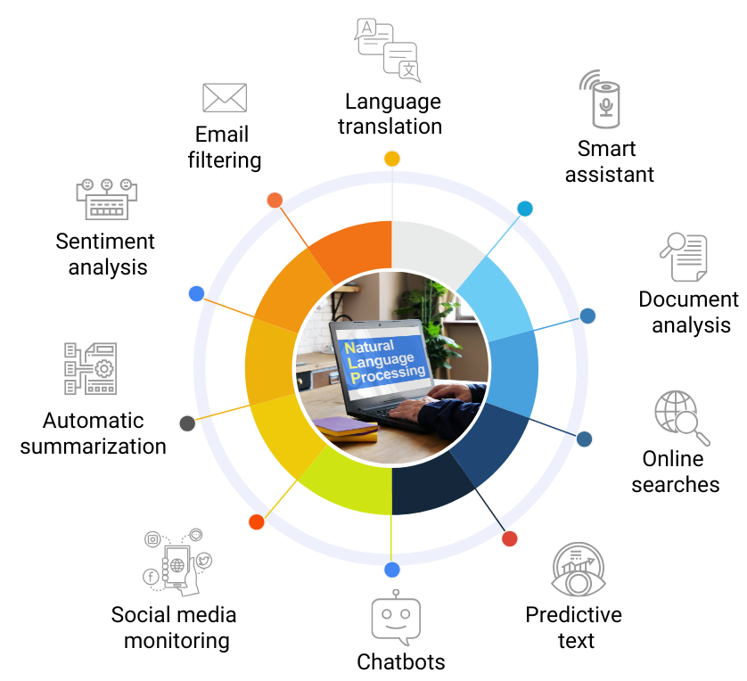
Everyday applications of NLP

Slide 7
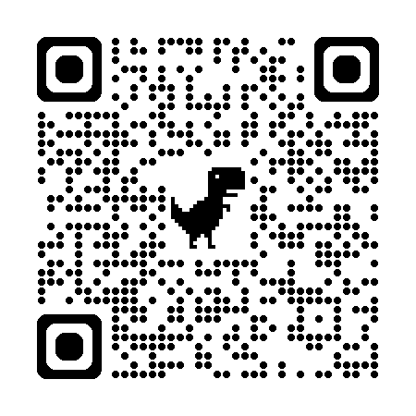
Learning Activity 1: Problem Based Learning
Read the Scenario: CityScape Tours Mobile App
Identify and list down all the NLP applications used in the CityScape Tours mobile app scenario. Consider how each technology enhances the user experience and contributes to the functionality of
https://drive.google.com/file/d/1Ww4LHugR_G8WzBUHE6semc8WVKahw3Lr/view

Slide 8
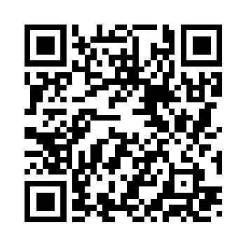
Learning Activity 1: Problem Based Learning
After reading from each table write down your response: Identify and list down all the NLP applications used in the CityScape Tours mobile app scenario. Consider how each technology enhances the user experience and contributes to the functionality of the app.
Go to wooclap.com
Enter the event code in the top banner
Event code
RSMGZO

Slide 9
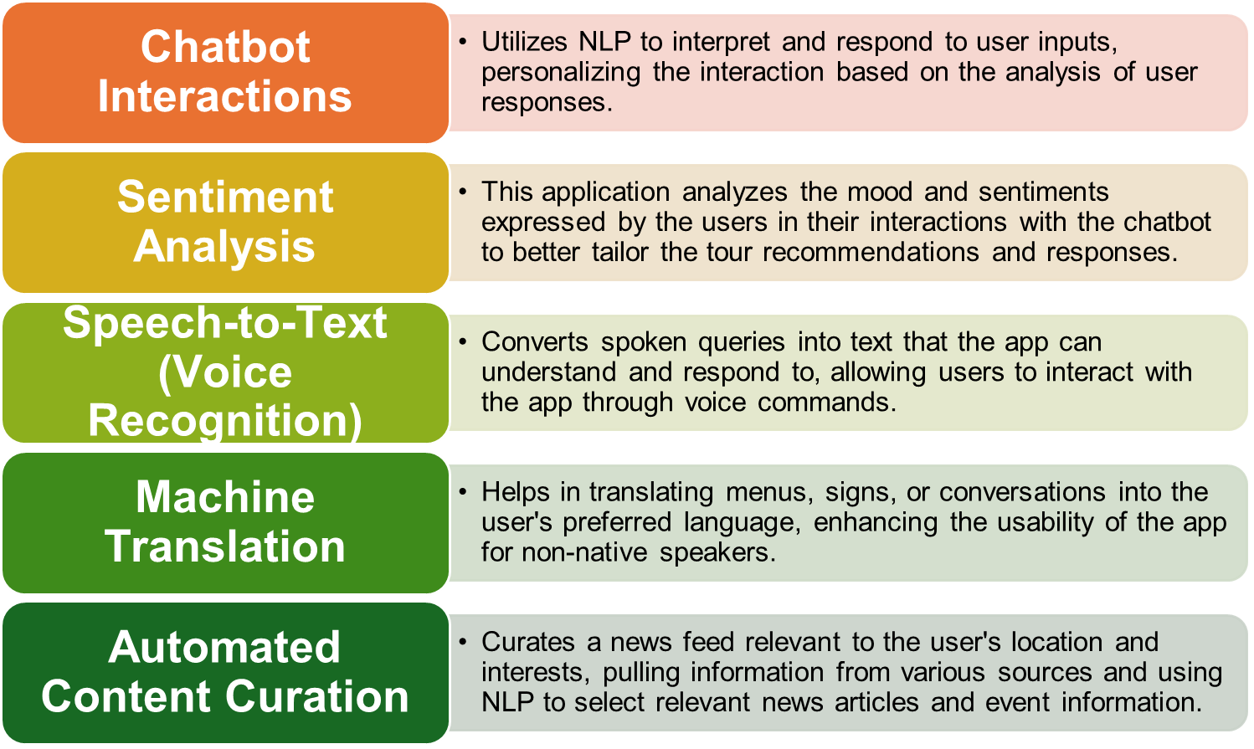
Reflection- Learning Activity 1

Slide 10
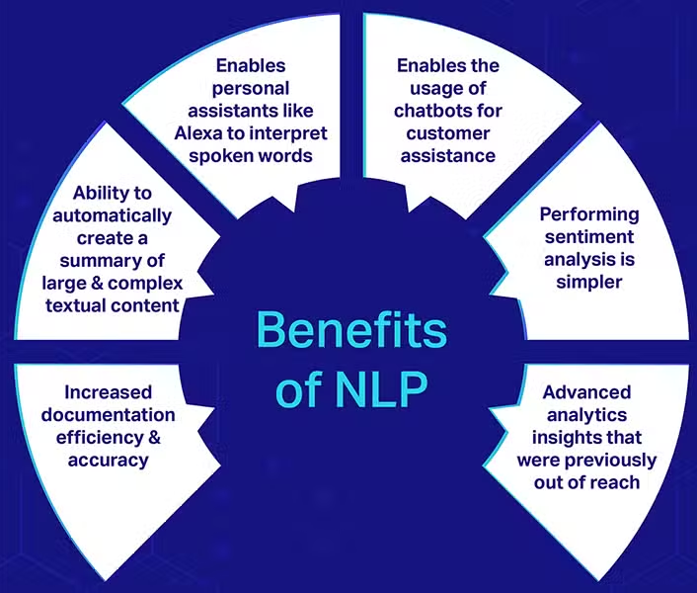
Benefits of NLP

Slide 11
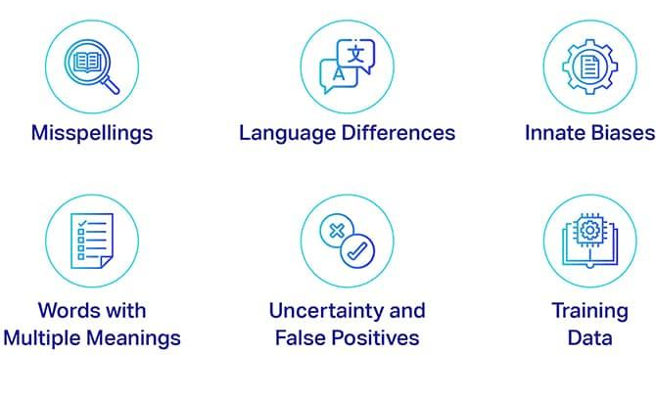
Challenges of NLP

Slide 12
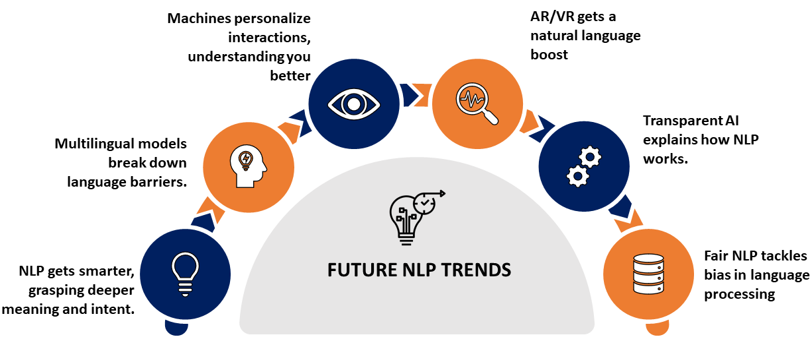
The future of NLP

Slide 13
Learning Activity 2: Matching
Decide which category each of the statements fits into best, ensuring category of benefit, challenge, and future of NLP.
Go to wooclap.com
Enter the event code in the top banner
Event code
RSMGZO

Slide 14
Reflection- Learning Activity 2

Slide 15
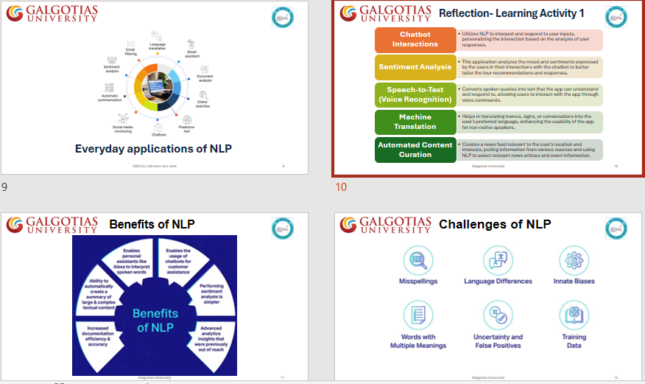
Summary

Slide 16
Ensure attainment of LOs in alignment to the learning activities: outcomes (1-2)
Outcome 1: Apply Knowledge of NLP Applications (Problem Based Learning)
Outcome 2: Evaluate NLP Development Dynamics (Matching)

Slide 17
Discussion on the post session activities

Slide 18
Information about the next lesson: Phases of NLP

Slide 19
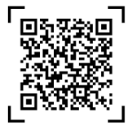
Review and Reflection from students

